Slide 1




SRS and SDS Defense
X-ray Image Classification For Pneumonia & COVID-19
Group:
20F-23
Team Leader :
Asad Ali
Members:
Muhammad Hussain
Um-E-Hani
Supervisor :
Dr. Ghulam Murtaza Memon

Slide 2




Problem Statement
Prone to error process
Critical process
Time consuming process

Slide 3

Solution
A Web Application
To automate the disease diagnosis using Deep Learning models, eliminating the need for expert radiologists through efficient image classification.

Slide 4
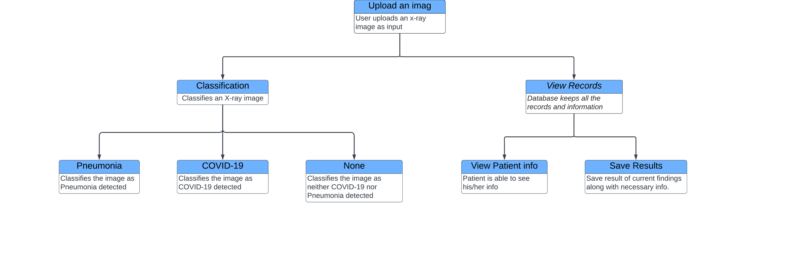
Functional Requirements

Slide 5


Functional Requirements
Functional Hierarchy
The User
Sign Up
Login
Upload X-ray Image
View Results
View Records(if any exists)
The System
Gets the X-ray Image
Classifies it as either
Pneumonia
COVID-19
Normal
Displays the result of the X-ray Image

Slide 6




Non-Functional Requirement
Performance Requirements
Safety Requirements
Security Requirements
User Documentation

Slide 7


Project Scope
Create a web-based diagnostic tool for respiratory conditions, emphasizing COVID-19 and pneumonia.
Use CNNs and deep learning for quick and accurate categorization of chest X-ray images.
Utilize Kaggle's "COVID-19+PNEUMONIA+NORMAL Chest X-Ray Image Dataset" for training and testing.
Address limited access to medical professionals by expediting diagnosis and empowering both doctors and patients.

Slide 8


Project Objectives
Develop an interactive AI web system for Pneumonia and COVID-19 diagnosis with a user-friendly interface, enabling X-ray image classification into Pneumonia, COVID-19, or normal.
1
Conduct experimental research, encompassing a comprehensive study of object classification techniques and an empirical evaluation of models like VGG for effective classification.

Slide 9






Constraints
Stakeholders
Software Constraints
Hardware Constraints
Cultural Constraints
Legal Constraints
Environmental Constraints
User Constraints
Healthcare providers
Patients and their families
Hospital Administrators
Governmental Regulatory Organizations
Research Institutions
Manufacturers
Professional Organizataions

Slide 10

External Interface Requirements
Software Interfaces
Hardware Interfaces
Communication Interfaces

Slide 11
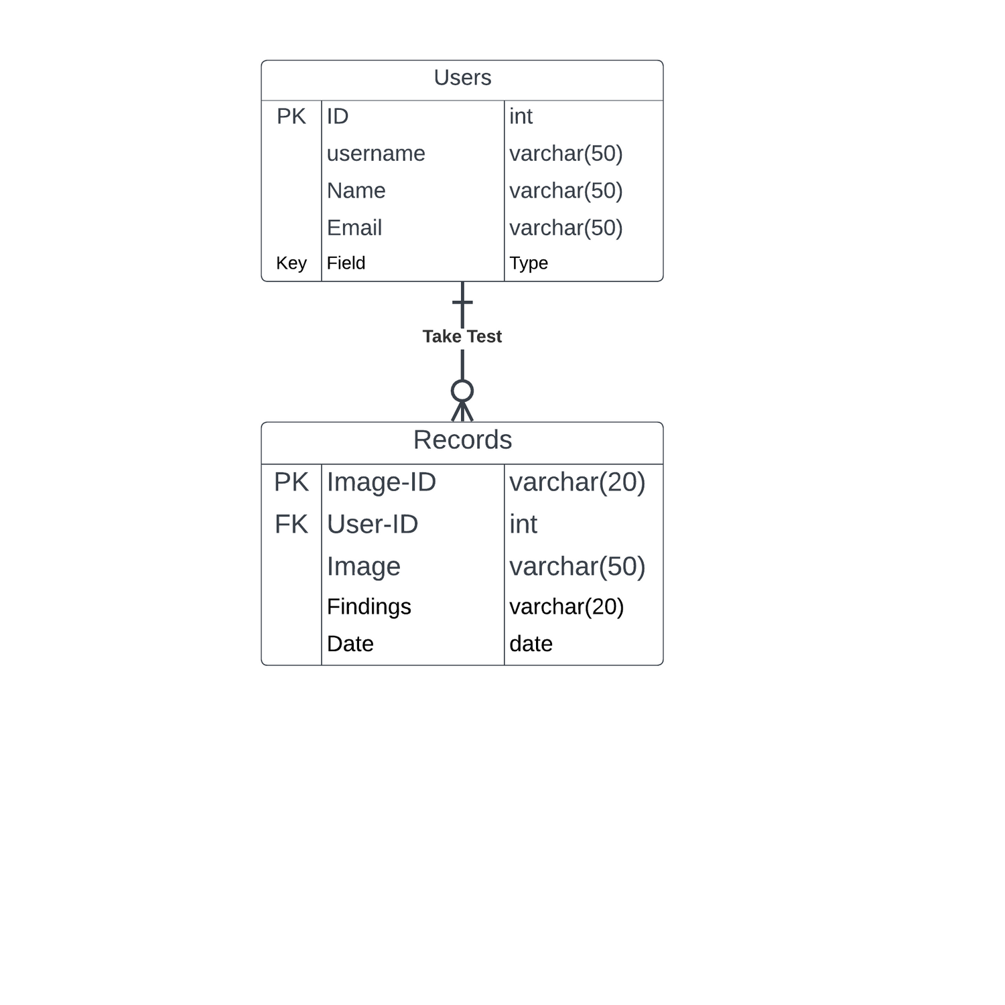
Entity-Relationship Diagram

Slide 12
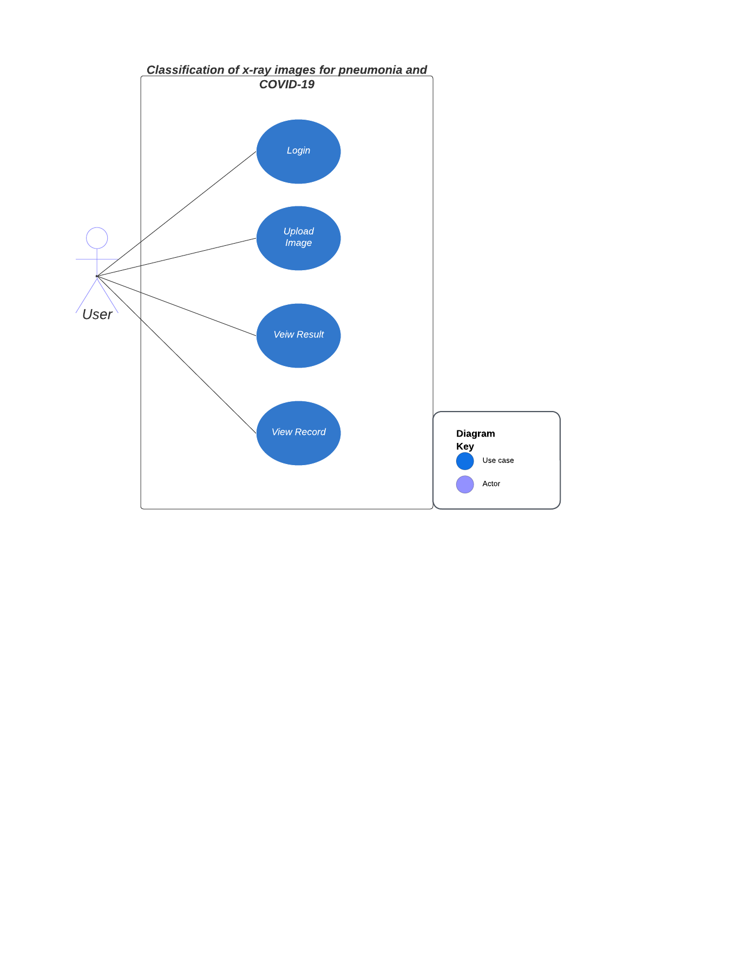
Use case Diagram

Slide 13
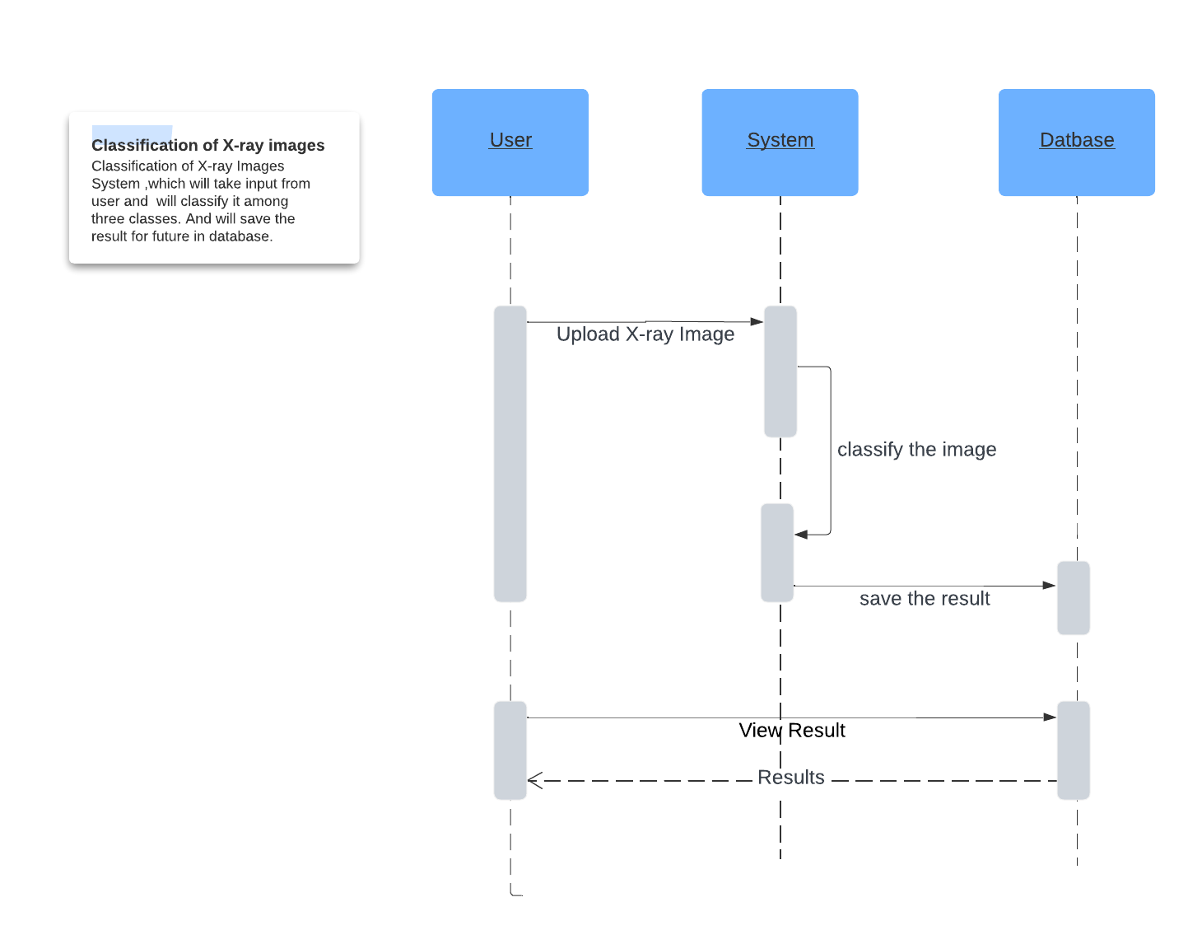
Sequence Diagram

Slide 14
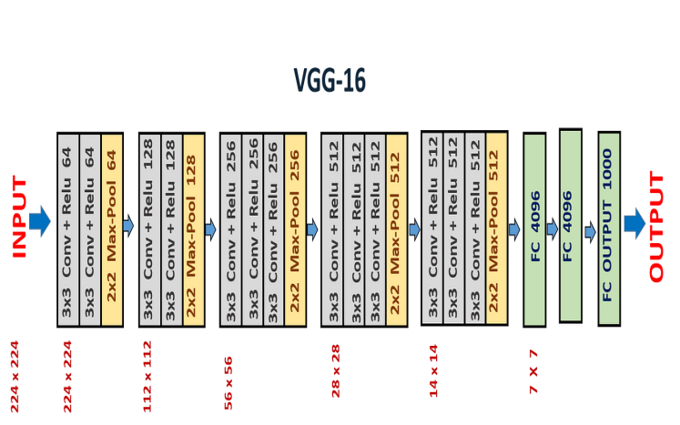
Detailed Software Design

Slide 15
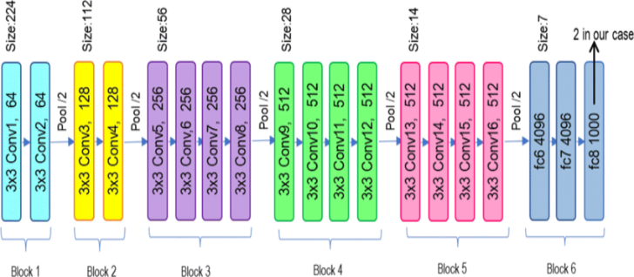
Detailed Software Design
VGG-19

Slide 16


Interface Design

Slide 17

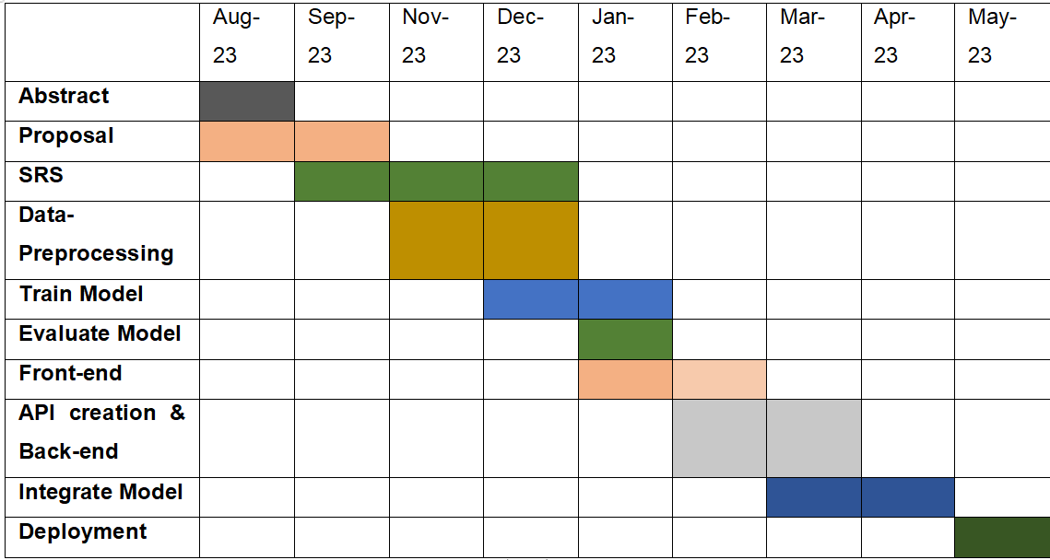
Project Timeline

Slide 18
Thank You!

